Slide 1
CUSTOMER BEHAVIOR ANALYSIS
DAB303 –Project 3

Slide 2

BUSINESS OBJECTIVE OF THE PROJECT
Understand and gain insights from an e-Commerce dataset, by performing various exploratory data analysis, data visualization, and data modelling tasks
Focus specifically on Customer Behavior Analysis (notions, applications, etc.)
Perform Advanced Data Science Analysis

Slide 3
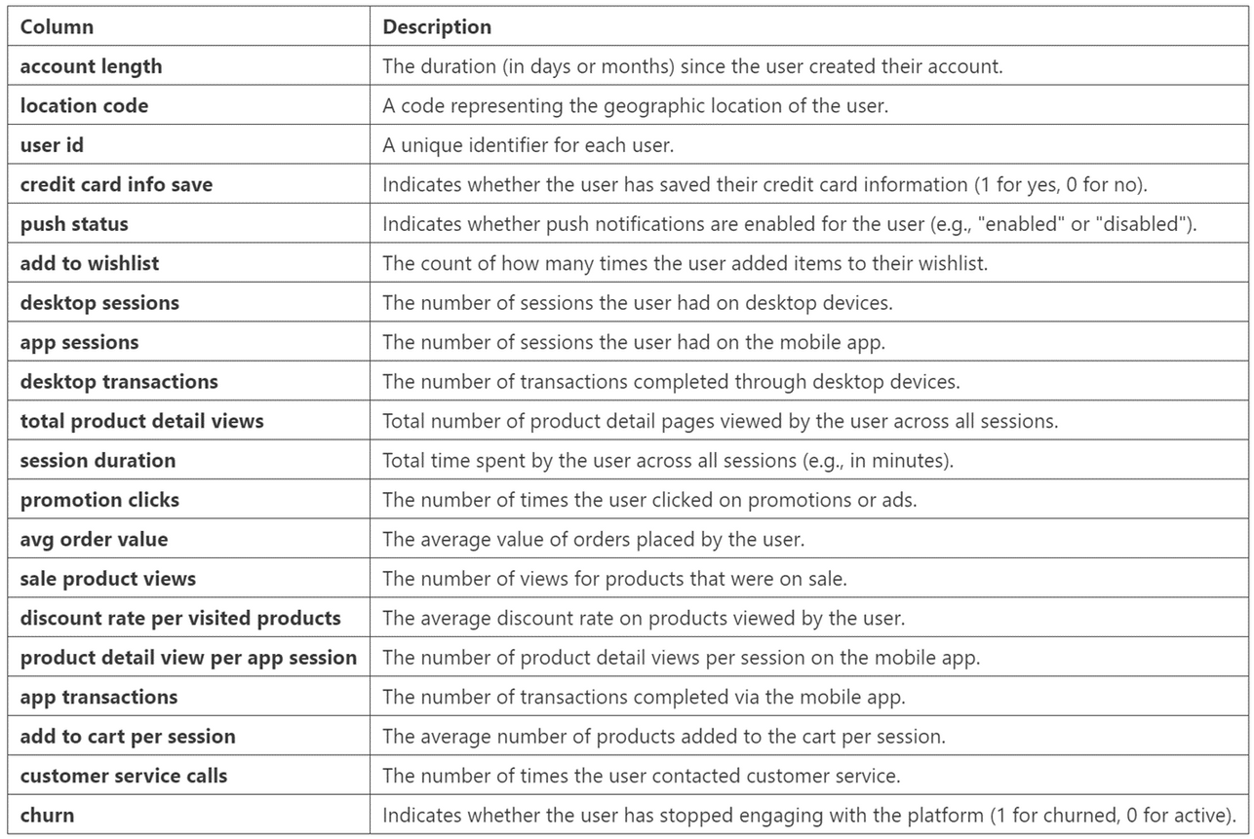

ABOUT THE DATASET – CUSTOMER BEHAVIORS
3,333 rows
20 columns

Slide 4
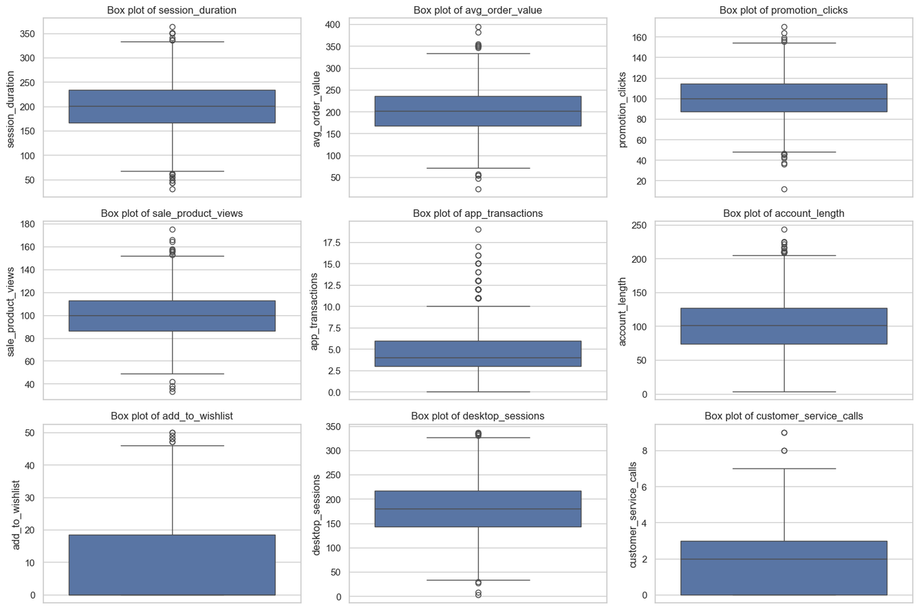
CHECK FOR OUTLIERS
Visualization Outliers – Box Plots
The analysis shows that most customer behaviors fall within a normal range, but several variables exhibit notable outliers. Session duration, average order value, and desktop sessions have typical mid-range activity with a few extremely high or low values. Most customers make around five app transactions, have accounts about 100 days old, and rarely contact customer service. Engagement levels, such as adding items to wishlists or clicking promotions, are generally low, though some users are highly active. Overall, the data suggests that while the majority of customers behave consistently, a small group shows significantly different interaction patterns.

Slide 5
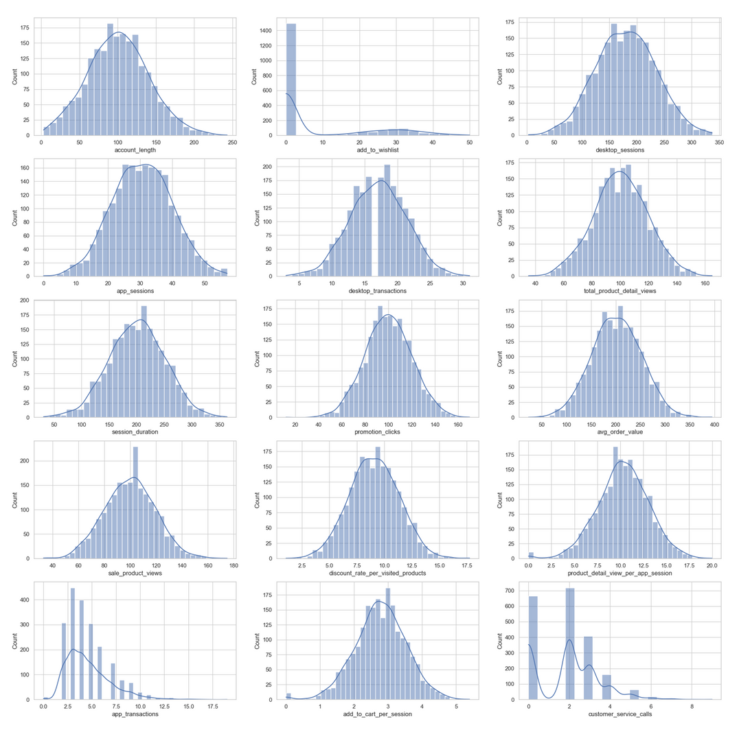
CHECK FOR OUTLIERS
Visualization Outliers – Histograms
The histograms show that most features are normally distributed, such as session duration, average order value, account length, and desktop sessions, all centered around typical mid-range values. In contrast, app transactions, add to wishlist, and customer service calls are right-skewed, indicating that most users have low activity with a few highly active outliers. Sale product views and promotion clicks also show mild right skewness, reflecting that a majority of customers engage moderately while a smaller group is significantly more active.

Slide 6
CONCLUSION ABOUT VISUALIZATIONS
The box plots reveal the range and outliers in the data, showing that several features (like promotion clicks, app transactions, and add-to-wishlist events) have a significant number of outliers, which can be critical in further analysis.
The histograms provide insights into the overall distribution of the data, with most features following a normal or right-skewed distribution, meaning that the majority of values are clustered around the median, with a tail extending to higher values.
Observations:
- Normality: Session duration, average order value, promotion clicks, sale product views, and account length have distributions that resemble a normal distribution.
- Skewness: App transactions, add to wishlist, and customer service calls exhibit right-skewed distributions, indicating that most customers exhibit lower values for these metrics with few high-value outliers.
- Outliers: Box plots for app transactions, customer service calls, and add to wishlist highlight the presence of significant outliers, indicating users with unusual behavior.
Based on these 2 visualizations, it suggests that while most customer behaviors follow expected patterns, certain metrics show skewed or extreme behaviors that could warrant further investigation, especially regarding how outliers impact the overall business outcomes.

Slide 7
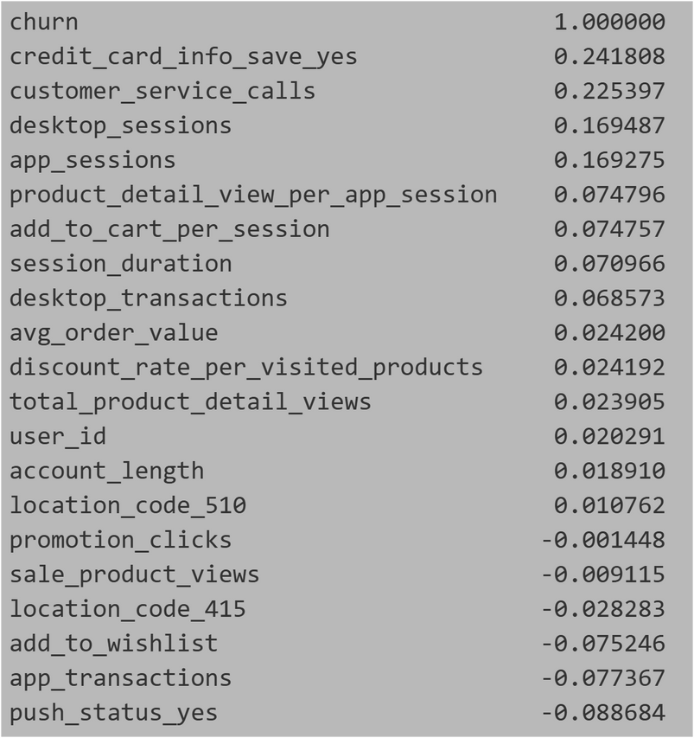
ANALYSIS OF THE DEPENDENT VARIABLE (CHURN) VS INDEPENDENT VARIABLES
Correlation ships between ‘churn’ and others
Until now we've looked into the numeric variables, their missing data, duplicates, distribution, and outliers. A key part of the customer behaviour data is to understand which "behaviours" aka idependent varialbes in our dataset can help us predict customers deciding to stop using the product, aka "churn".
Another variable that we haven't analysed yet is the location code, but we might be able to find value in comparing it with the churn and finding out any potential correlations.
Features such as saving credit_card_info_say_yes(0.2418) and customer_service_calls(0.2254) show positive correlations with churn, indicating that customers engaging in these actions are more likely to churn.
On the other hand, features like push_status_yes (-0.0887) and app_transactions (-0.0774) have negative correlations, suggesting that users receiving push notifications or conducting transactions in the app are less likely to churn.

Slide 8
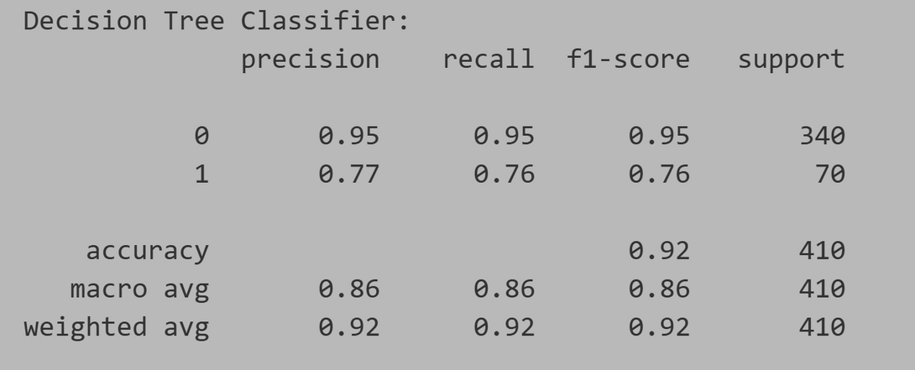
PREDICTION OF CHURN
Class 0 (Majority Class):
•Precision: 0.94 – Out of all predicted class 0, 94% were correct.
•Recall: 0.99 – Out of all actual class 0, 99% were correctly classified.
•F1-score: 0.96 – The harmonic mean of precision and recall, showing excellent overall performance for class 0.
•Support: 340 – There were 340 instances of class 0.
Class 1 (Minority Class):
•Precision: 0.90 – Out of all predicted class 1, 90% were correct.
•Recall: 0.67 – Out of all actual class 1, only 67% were correctly classified, indicating the model is missing many of the actual class 1 instances.
•F1-score: 0.77 – A lower score compared to class 0, showing the classifier struggles with class 1.
•Support: 70 – There were 70 instances of class 1.
Overall :
•Accuracy: 0.93 – The model correctly classified 93% of the total instances, a good result overall.
•Macro Average:
•Precision: 0.92 – An unweighted average precision score.
•Recall: 0.83 – The macro recall is lower, mainly due to the poor recall for class 1.
•F1-score: 0.87 – Reflects the imbalanced performance between the two classes.
•Weighted Average:
•Precision: 0.93 – Accounts for the number of instances in each class.
•Recall: 0.93 – Since class 0 has more instances, its high recall boosts the weighted average.
•F1-score: 0.93 – Shows overall good performance but still reflects the imbalance.
------------------------------------------------------
Prediction using DecisionTreeClassifier training model
=> Class 0: The model performs very well on the majority class, with high precision (0.94) and recall (0.99), leading to a strong F1-score of 0.96.
=> Class 1: The model performs well in terms of precision (0.90), but its recall for class 1 is relatively low (0.67), indicating it struggles to identify all instances of class 1. This is also reflected in the lower F1-score (0.77).
=> Overall: The accuracy is high at 0.93, but the recall for class 1 (0.67) indicates a challenge in correctly identifying minority class instances. The macro average is lower than the weighted average due to this imbalance.

Slide 9
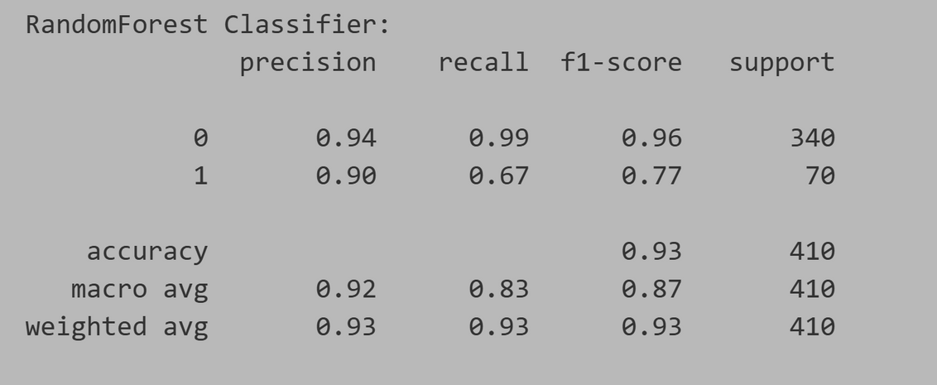
PREDICTION OF CHURN
Class 0 (Majority Class):
•Precision: 0.95 – Out of all predicted class 0, 95% were correctly classified.
•Recall: 0.95 – Out of all actual class 0, 95% were correctly classified.
•F1-score: 0.95 – The harmonic mean of precision and recall.
•Support: 340 – There were 340 instances of class 0.
•
Class 1 (Minority Class):
•Precision: 0.77 – Out of all predicted class 1, 77% were correct.
•Recall: 0.76 – Out of all actual class 1, 76% were correctly classified.
•F1-score: 0.76 – The harmonic mean of precision and recall.
•Support: 70 – There were 70 instances of class 1.
•
•Accuracy: 0.92 – The model correctly classified 92% of the total instances.
•Macro Average: 0.86 for precision, recall, and F1-score – This is the unweighted average, treating both classes equally.
•Weighted Average: 0.92 – This average accounts for the number of instances in each class (class 0 has much more support than class 1).
----------------------------------------------
Prediction using RandomForestClassifier training model
The model performs better on the majority class (class 0) with high precision, recall, and F1-score.
For the minority class (class 1), performance is lower, particularly in precision (0.77) and recall (0.76), indicating some difficulty in predicting the minority class.
The overall accuracy is quite high (0.92), but the difference in class performance is reflected in the macro and weighted averages.

Slide 10
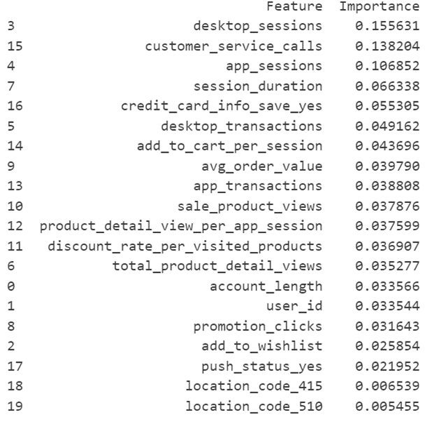
FEATURE IMPORTANCE FROM RANDOMFOREST
The most influential factors driving customer behavior are desktop_sessions, customer_service_calls, and app_sessions, suggesting that both online engagement and customer support interactions strongly affect outcomes.
Lower importance for location codes and push notifications indicates that geography and alerts play a minor role in predicting customer actions.

Slide 11
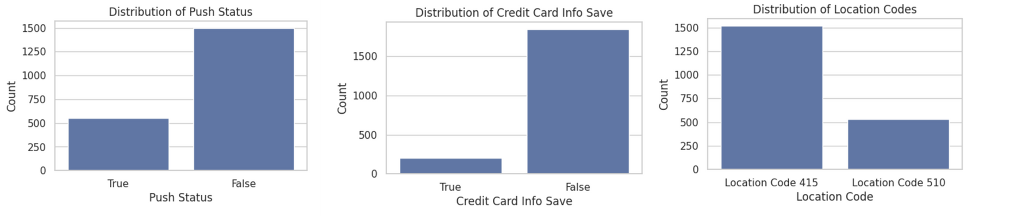
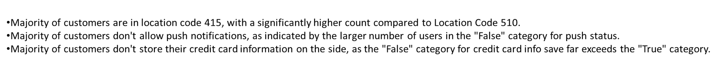
OBSERVATION FROM THE CATEGORICAL DATA
Categorical Data – push_status, credit_card_info_save, location_code

Slide 12
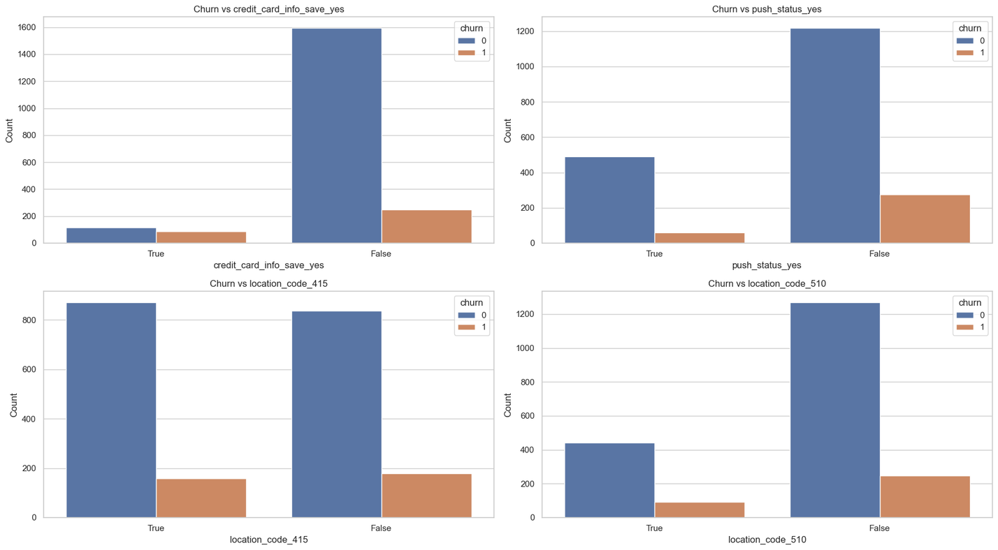
CHURN AGAINST THE CATEGORICAL DATA
Insights:
•Credit Card Info Save: Customers who save their credit card info are much less likely to churn. Not saving info correlates with higher churn.
•Push Status: Customers with push notifications enabled have lower churn rates. Most customers without push notifications churn more.Location
•Code 415: This location has a lower churn rate compared to others, indicating better customer retention.Location
•Code 510: Churn is slightly higher here than in Location Code 415, suggesting the need for more targeted retention efforts.
Recommendations:
•Encourage saving payment info to reduce churn.
•Promote push notifications to engage and retain customers.
•Target Location Code 510 with specific retention strategies.
•Maintain efforts in Location Code 415 to keep churn low.

Slide 13
THANK YOU!

